Slide 1
Industrial Training Report ON Machine Learning Specialization
Naman Kapoor
00614811622

Slide 2
About Coursera Andrew Ng Machine Learning Specialization
The Machine Learning Specialization by Andrew Ng on Coursera offers a comprehensive introduction to key machine learning concepts, including supervised and unsupervised learning, neural networks, support vector machines (SVMs), and model evaluation. It covers foundational algorithms such as linear regression, logistic regression, and clustering techniques like k-means and PCA. The specialization includes practical programming assignments and culminates in a capstone project where learners apply these concepts to real-world problems. It's suitable for both beginners and experienced individuals, providing hands-on skills and a solid understanding of machine learning.

Slide 3
Abstract
This project focuses on face detection and privacy preservation using Python, OpenCV, and MediaPipe. It leverages MediaPipe's advanced machine learning techniques for real-time face detection in images and video streams, identifying key facial landmarks to apply targeted blurring. OpenCV enhances this process by providing image processing capabilities, allowing for effective face anonymization. The system delivers real-time performance and works well in various conditions, ensuring privacy while maintaining content context. The project also addresses ethical concerns regarding facial recognition technology and highlights the importance of privacy in modern digital applications.

Slide 4
Project: Face Anonymizer OBJECTIVE:
Implement MediaPipe for Face Detection: Use the MediaPipe framework to detect and track faces in real-time from images and video streams with high accuracy.
Integrate OpenCV for Image Processing: Utilize OpenCV for blurring facial features while maintaining the surrounding context, ensuring effective privacy measures.
Achieve Real-time Performance: Develop a system capable of real-time face detection and blurring, suitable for live video processing with minimal latency.
User Interaction: Create a user-friendly interface for adjusting blurring intensity, starting/stopping video processing, and toggling face detection features.

Slide 5
Project: Face Anonymizer OBJECTIVE:
Evaluate Detection Accuracy: Test the accuracy and reliability of the MediaPipe face detection model across various conditions like lighting, angles, and distances.
Address Privacy Concerns: Discuss the ethical aspects of face detection, focusing on privacy protection in facial recognition applications.
Documentation and Reporting: Provide detailed documentation on the implementation process, including code, challenges faced, and final outcomes.
Explore Potential Applications: Investigate applications such as social media, security, and augmented reality, and consider potential improvements or future extensions of the system.

Slide 6
Project: Face Anonymizer BACKGROUND:
This project explores face detection and privacy preservation using MediaPipe and OpenCV. With face detection being vital in applications like security and augmented reality, there is a growing need for efficient algorithms, especially in privacy-sensitive contexts. MediaPipe offers real-time, precise face detection by identifying facial landmarks, while OpenCV provides powerful image processing tools, including blurring techniques. By integrating both frameworks, this project creates a system that detects faces and obscures facial features, ensuring privacy. The solution addresses the dual objectives of accurate face detection and privacy protection in today’s digital world.

Slide 7
Project: Face Anonymizer TOOLS AND TECHNOLOGY USED:
Python: A user-friendly high-level programming language that simplifies rapid development for computer vision tasks, supported by extensive libraries for complex algorithms.
MediaPipe: A cross-platform framework by Google for building machine learning pipelines, offering efficient real-time face detection and facial landmark tracking using advanced techniques.
OpenCV: An open-source library tailored for real-time computer vision applications, utilized for face detection, image processing, and applying blur effects to facial regions in this project.
NumPy: A powerful numerical computing library in Python, essential for handling large arrays and matrices, supporting mathematical operations required for image manipulation.

Slide 8
Project: Face Anonymizer TOOLS AND TECHNOLOGY USED:
Matplotlib: A plotting library used to visualize images and data, helpful in displaying the face detection and blurring results.
IDE: Integrated Development Environments such as Jupyter Notebook, PyCharm, or Visual Studio Code were used for coding, debugging, and testing, providing features like syntax highlighting and interactive development.
Camera: A webcam or external camera for real-time video input, enabling live face detection and blurring.
Operating System: The project is cross-platform compatible, supporting development on Windows, macOS, and Linux.

Slide 9
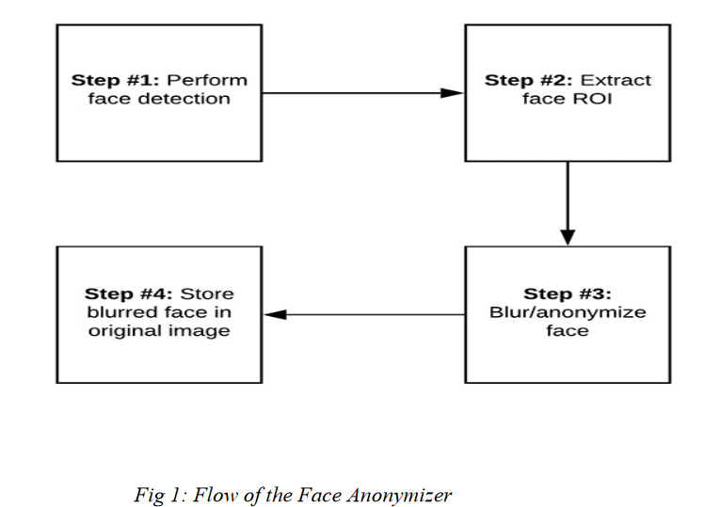
Project: Face Anonymizer Methodology:

Slide 10
Project: Face Anonymizer Methodology:
The project follows a systematic approach for face detection and blurring using Python, OpenCV, and MediaPipe:
Setup and Installation: Install Python and necessary libraries (OpenCV, MediaPipe, NumPy, Matplotlib). Configure the IDE and ensure access to a camera or video input for real-time processing.
Face Detection Using MediaPipe: Integrate MediaPipe to detect facial landmarks in static images or video streams. Optionally, use grayscale conversion for faster processing. Detect and mark facial landmarks for precise face identification.
Blurring Using OpenCV: Extract the region of interest (ROI) based on detected landmarks, apply a blurring effect to the face, and replace the original face with the blurred version in the image or video.

Slide 11
Project: Face Anonymizer Methodology:
Real-time Processing: Capture video frames and process them in real-time by detecting faces and applying blur. Display the processed frames immediately.
User Control and Interaction: Allow users to adjust blurring intensity, toggle detection or blurring, and monitor system performance (e.g., frame rate) for smooth operation.
Performance Evaluation: Test the accuracy of face detection and blurring under varying conditions, and evaluate real-time performance in terms of frame rate and processing speed.
Ethical Considerations: Reflect on the ethical implications of face detection technology, focusing on privacy concerns, responsible use, and balancing technical capabilities with privacy protection.

Slide 12
Project: Face Anonymizer Implementation:
The implementation of face detection and blurring using Python, OpenCV, and MediaPipe involves the following steps:
Library Installation: Install OpenCV, MediaPipe, and NumPy using pip.
MediaPipe Initialization: Configure MediaPipe’s face detection model with a minimum confidence threshold (~0.5) for real-time face detection.
Video Capture: Use OpenCV’s VideoCapture to stream live video.
Face Detection: Process each video frame by converting it to RGB and using MediaPipe to detect faces and generate bounding boxes.

Slide 13
Project: Face Anonymizer Implementation:
Blurring Faces: Apply OpenCV's blur function to the detected face region (ROI) using the bounding box and replace the original region.
Real-time Display: Display processed frames with blurred faces using OpenCV’s imshow.
User Control: Allow users to stop the process with a keypress (e.g., 'q').
Adjusting Blur: Users can adjust the blur intensity by changing the kernel size in the blur function.
Performance Monitoring: Monitor frame rate for smooth real-time processing. MediaPipe's efficient model ensures minimal overhead.

Slide 14
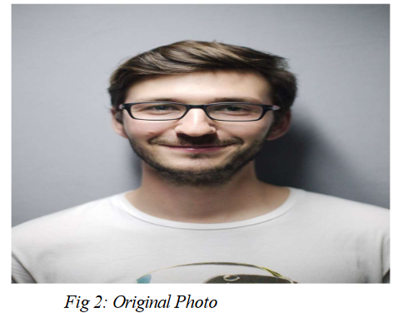
Project: Face Anonymizer Results and Outcome:

Slide 15
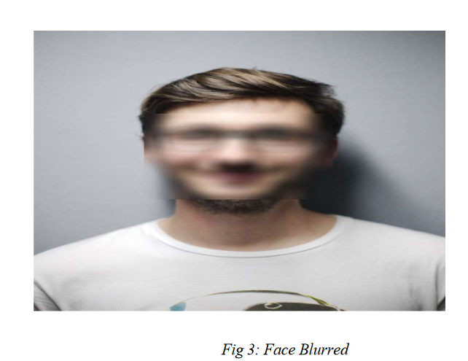
Project: Face Anonymizer Results and Outcome:

Slide 16
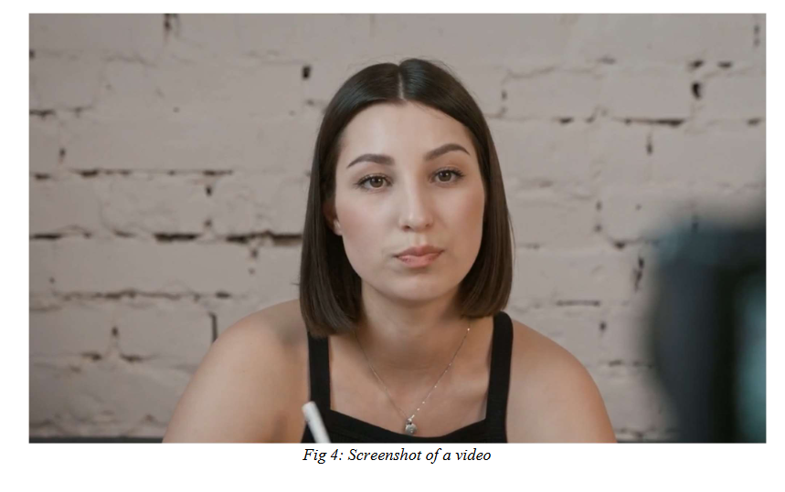
Project: Face Anonymizer Results and Outcome:

Slide 17
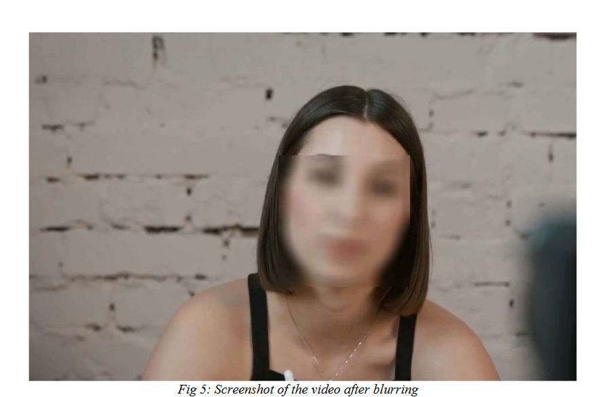
Project: Face Anonymizer Results and Outcome:

Slide 18
Project: Face Anonymizer Challenges Faced:
Performance issues due to real-time processing demands.
Lighting and environmental factors affecting detection accuracy.
Handling extreme angles and occlusions in face detection.
Managing multiple face detections in a single frame.
Tuning blurring intensity for effective privacy without distortion.
Memory management and resource usage during real-time processing.
Ethical concerns regarding consistent and reliable privacy protection.

Slide 19
Project: Face Anonymizer Skills Gained:
Computer Vision: Expertise in face detection and image processing using OpenCV and MediaPipe.
Real-time Processing: Proficient in handling and processing live video streams efficiently.
OpenCV Skills: Developed skills in image manipulation, including handling regions of interest (ROI) and applying blur effects.
MediaPipe Mastery: Gained experience with MediaPipe’s face detection model for real-time facial landmark detection.
Python Proficiency: Enhanced Python coding abilities, focusing on optimization and debugging.
Performance Optimization: Learned to optimize systems for real-time performance and resource management.

Slide 20
Project: Face Anonymizer CONCLUSION:
The implementation of face detection and blurring using Python, OpenCV, and MediaPipe effectively addresses privacy concerns in real-time video processing. By detecting faces and applying customizable blurs, the system anonymizes sensitive visual data, making it suitable for applications like social media moderation, live streaming, surveillance, and video conferencing.
The project tackled several technical challenges, including achieving real-time performance and managing variations in lighting and face angles. These were resolved through performance tuning, efficient coding, and problem-solving, resulting in a system that balances accuracy, speed, and usability while respecting privacy.
Significant skills were gained in computer vision, real-time processing, Python programming, and performance optimization, highlighting the importance of responsible design in handling personal data. This work lays a foundation for further exploration in privacy technologies and advanced face recognition systems, adapting to evolving user needs and trends.

Slide 21
Project: Face Anonymizer FUTURE SCOPE:
The face detection and blurring system has several potential improvements:
Accuracy: Integrate advanced detection models (e.g., YOLO) and 3D modeling for better performance in challenging conditions.
Dynamic Techniques: Explore adaptive blurring and selective feature obfuscation for nuanced privacy control.
Face Recognition: Combine with recognition capabilities for authorized individuals while anonymizing others.
Performance: Utilize GPU acceleration and edge device deployment for efficient processing.
Broader Applications: Implement automated content moderation and adapt for AR/VR environments.
Compliance: Integrate tools for GDPR/CCPA compliance.
User Features: Develop a user interface for customization and expand to mobile/web platforms for wider accessibility.

Slide 22
REFERENCES:
1. Ng, A. (2021). Machine Learning [Online Course]. Coursera. Available:
Coursera Andrew Ng Machine Learning Specialization
2. Ng, A. (2021). Deep Learning Specialization [Online Course]. Coursera.
Available: Coursera Deep Learning Specialization
3. Goodfellow, I., Bengio, Y., & Courville, A. (2016). Deep Learning. MIT
Press. Available: Deep Learning Book
4. Géron, A. (2019). Hands-On Machine Learning with Scikit-Learn, Keras,
and TensorFlow. O'Reilly Media. ISBN: 978-1492032649.
5. Raschka, S., & Mirjalili, V. (2019). Python Machine Learning. Packt
Publishing. ISBN: 978-1789615857.
6. Scikit-learn Documentation. (n.d.). Scikit-learn: Machine Learning in
Python. Available: Scikit-learn Documentation
7. OpenCV Documentation. (n.d.). OpenCV: Open Source Computer Vision
Library. Available: OpenCV Documentation

Slide 23
REFERENCES:
8. Bishop, C. M. (2006). Pattern Recognition and Machine Learning.
Springer. ISBN: 978-0387310732.
9. Murphy, K. P. (2012). Machine Learning: A Probabilistic Perspective. MIT
Press. ISBN: 978-0262033189.
10. Hastie, T., Tibshirani, R., & Friedman, J. (2009). The Elements of Statistical
Learning: Data Mining, Inference, and Prediction. Springer. Available:
ESL Book
11. Fan, H., Lin, L., & Wang, X. (2019). "Face Anonymization for Privacy
Protection Using Adversarial Networks." IEEE Transactions on
Information Forensics and Security, 14(6), 1485-1499. DOI:
10.1109/TIFS.2019.2896262
12. Rössler, A., Cozzolino, D., Verma, S., et al. (2019). "FaceForensics++:
Learning to Detect Manipulated Facial Images." IEEE/CVF International
Conference on Computer Vision (ICCV), 1-10. DOI:
10.1109/ICCV.2019.00010

